Slide 1
The Battle of Neighbourhoods
- Jayasakthi Devaraj

Slide 2
Introduction and Business Problem
The objective of this capstone project is to find the most suitable location for the entrepreneur to open a new Indian Restaurant in Manhattan, New York. By using data science methods and tools along with machine learning algorithms such as clustering, this project aims to provide solutions to answer the business question: In Manhattan, if an entrepreneur wants to open an Indian Restaurant, where should they consider opening it?

Slide 3
DATA
To solve this problem, we will need below data:
● List of neighborhoods in Manhattan, New York.
● Latitude and Longitude of these neighborhoods.
● Venue data related to Indian restaurants. This will help us find neighborhoods that are more suitable to open an Indian Restaurant.

Slide 4
EXTRACTING THE DATA
● The loading of New York neighborhoods from new_york_dataset.
● Getting Latitude and Longitude data of these neighborhoods via
Geocoder package.
● Using Foursquare API to get venue data related to these
neighborhoods.

Slide 5
METHODOLOGY
First, I need to get the list of neighborhoods in New York. This is possible by extracting the list of neighborhoods from Dataset - https://cocl.us/new_york_dataset
I downloaded the file by utilizing pandas wget method asit is easier and more convenient to pull tabular data directly from a webpage into the data frame. However, it is only a list of neighborhood names and Borough. I need to get their coordinates to utilize Foursquare to pull the list of venue near these Manhattan Borough. To get the coordinates, I tried using Geocoder Package . After gathering these coordinates, I visualize the map of Manhattan using Folium package to verify whether these are correct coordinates. Next, I use Foursquare API to pull the list of top 100 venues within 500 meters radius. I have created a Foursquare developer account in order to obtain account ID and API key to pull the data. From Foursquare, I am able to pull the names, categories, latitude, and longitude of the venues. With this data, I can also check how many unique categories that I can get from these venues. Then, I analyze each neighborhood by grouping the rows by neighborhood and taking the mean on the frequency of occurrence of each venue category. This is to prepare clustering to be done later.
Here, I made a justification to specifically look for “Indian restaurants”.
Lastly, I performed the clustering method by using k-means clustering.I have clustered the neighborhoods in Manhattan,New York into 3 clusters based on their frequency of occurrence for “Indian food”. Based on the results (the concentration of clusters), I will be able to recommend the ideal location to open the restaurant.

Slide 6
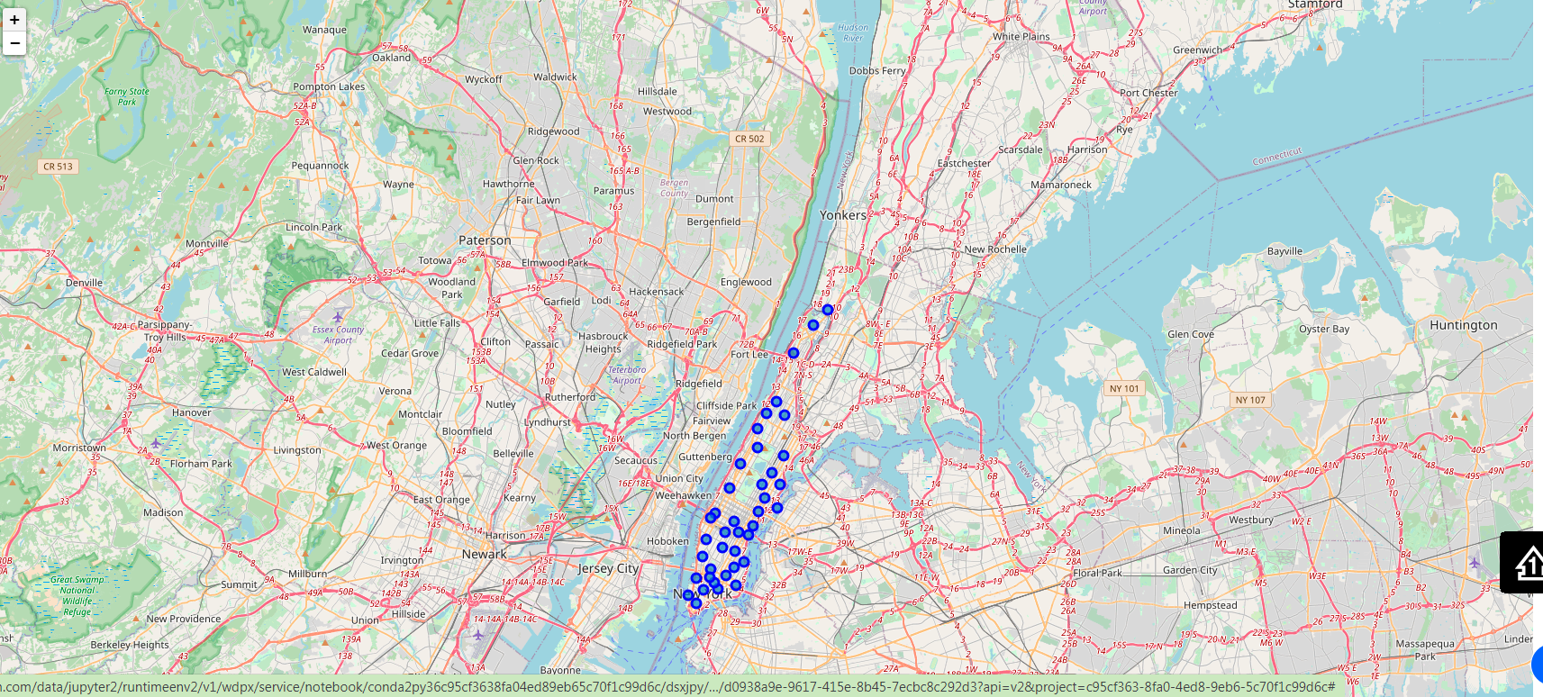
Plot of all Neighborhoods of Manhattan that were extracted:

Slide 7
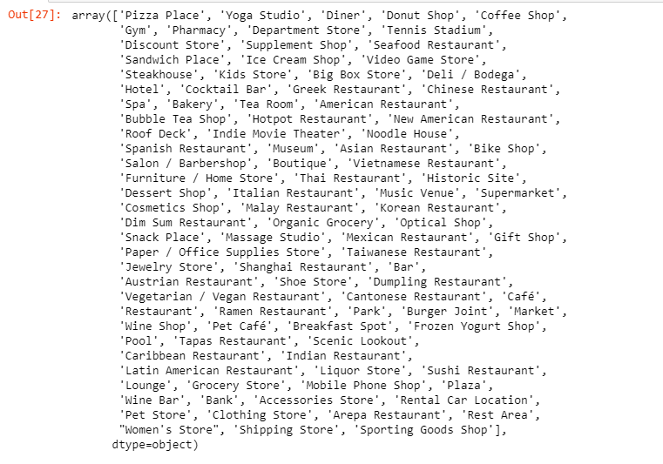
100 Unique Categories From Returned Venues

Slide 8
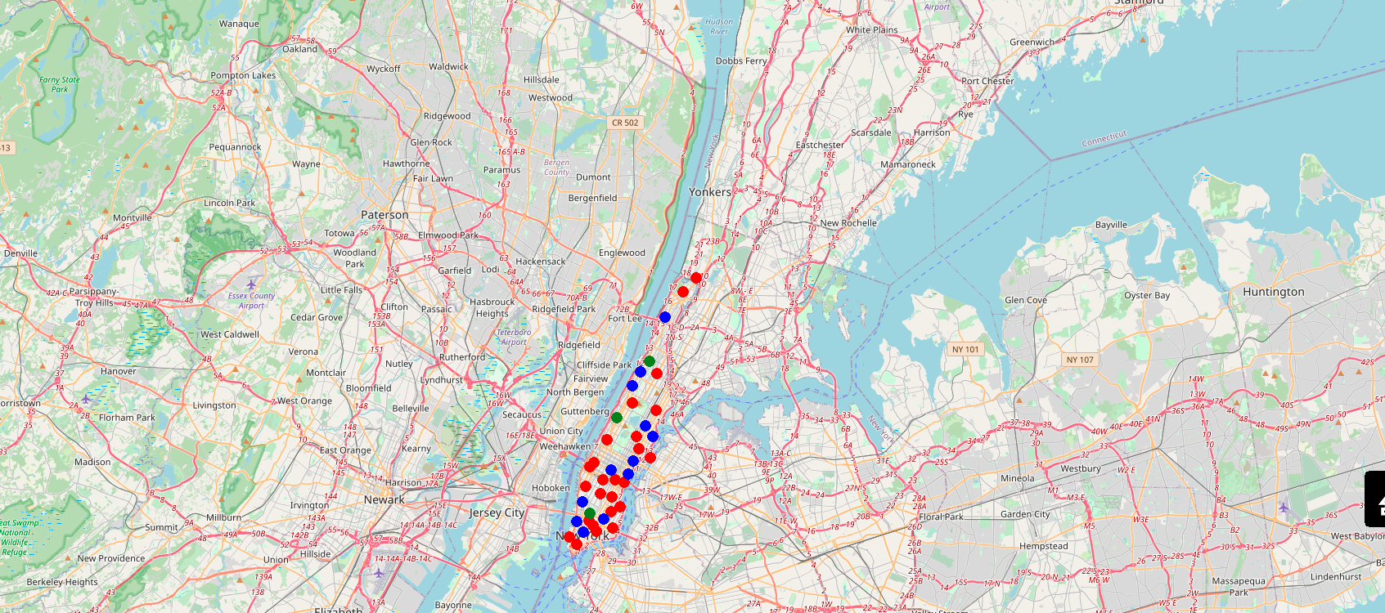
*k*-means to cluster the neighborhood into 3 clusters

Slide 9
Results
The results from k-means clustering show that we can categorize Manhattan neighborhoods into 3 clusters based on how many Indian restaurants are in each neighborhood:
● Cluster 0: Neighborhoods with no Indian restaurants.
● Cluster 1: Neighborhoods with less number of Indian restaurants.
● Cluster 2: Neighborhoods with a more number of Indian restaurants
The results are visualized in the above map with Cluster 0 in green,
Cluster 1 in blue, Cluster 2 in red.

